Slide 1
Electric Potential Energy and
Electric Potential

Slide 2
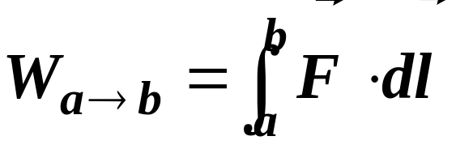
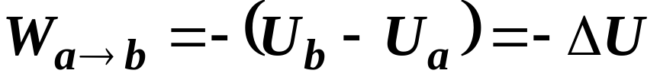
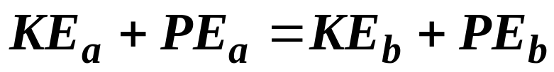
Energy Considerations
When a force, F, acts on a particle, work is done on the particle in moving from point a to point b
If the force is a conservative, then the work done can be
expressed in terms of a change in potential energy
Also if the force is conservative, the total energy of the
particle remains constant

Slide 3
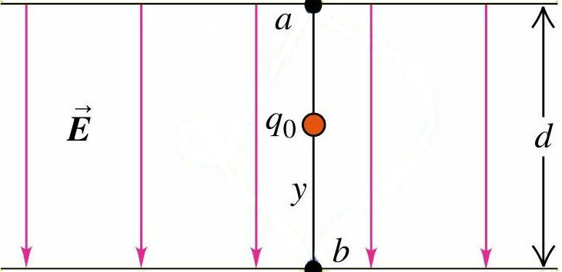
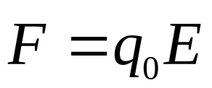
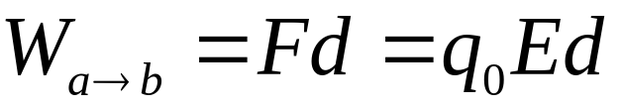
Work Done by Uniform Electric Field
Force on charge is
Work is done on the
charge by field
The work done is independent of path taken from point a to point b because
The Electric Force is a conservative force

Slide 4
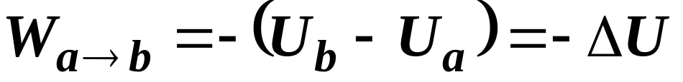
Electric Potential Energy
The work done by the force is the same as the change in the particle’s potential energy
The work done only depends upon the change in position

Slide 5
Electric Potential Energy
General Points
1) Potential Energy increases if the particle moves in the direction opposite to the force on it
Work will have to be done by an external agent for this to occur…..(Gravitational)
and
2) Potential Energy decreases if the particle moves in the same direction as the force on it

Slide 6
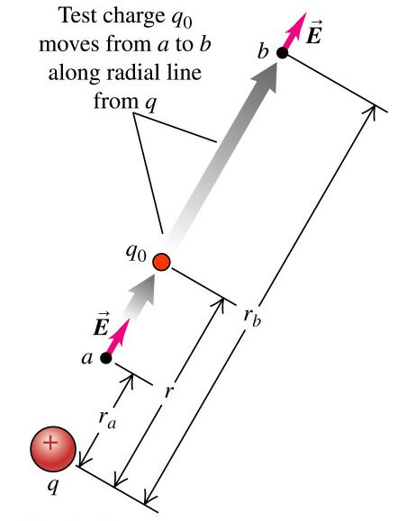
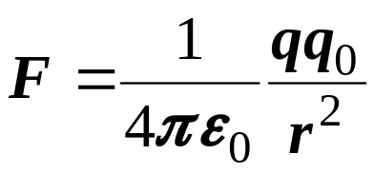
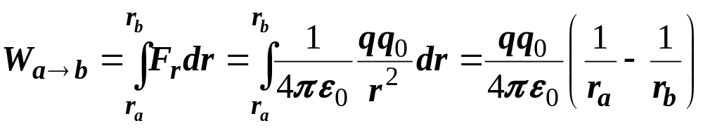
Potential Energy of Two Point Charges
Suppose we have two charges q and q₀ separated by a distance r
The force between the two charges is given by Coulomb’s Law
We now displace charge q₀ along a radial line from point a to point b
The force is not constant during this displacement

Slide 7
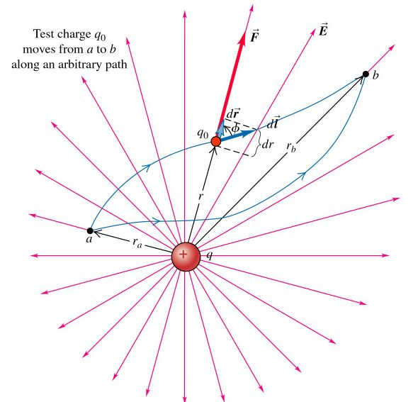
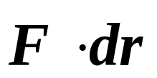
Potential Energy of Two Point Charges
The work done is not dependent upon the path taken in getting from point a to point b
The work done is related to the component of the force along the displacement

Slide 8
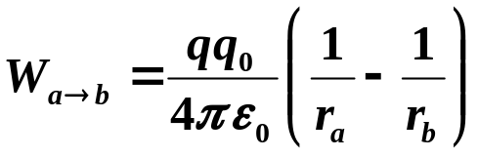
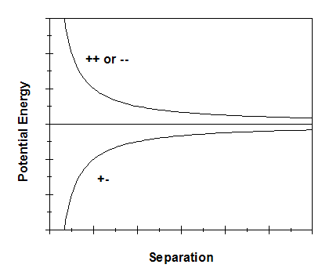
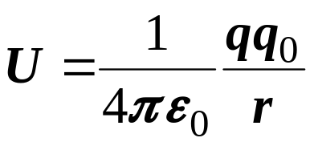
Potential Energy
Looking at the work done we notice that there is the same functional at points a and b and that we are taking the difference
We define this functional to be the potential energy
The signs of the charges are included in the calculation
The potential energy is taken to be zero when the two charges are infinitely separated

Slide 9
A System of Point Charges
Suppose we have more than two charges
Have to be careful of the question being asked
Two possible questions:
1) Total Potential energy of one of the charges with respect to remaining charges
or
2) Total Potential Energy of the System

Slide 10
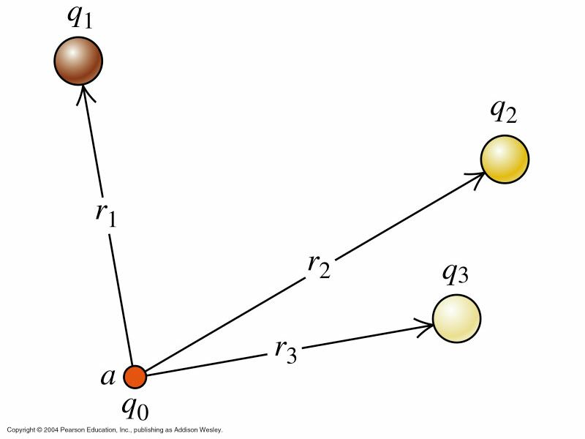
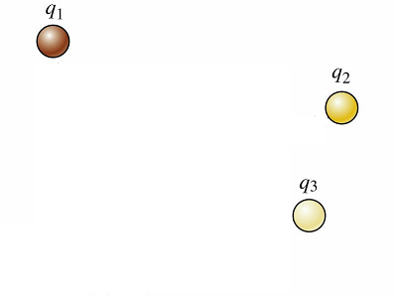
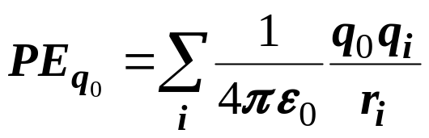
Case 1: Potential Energy of one charge with respect to others
Given several charges, q₁…q_{n}, in place
Now a test charge, q₀, is brought into position
Work must be done against the electric fields of the original charges
This work goes into the potential energy of q₀
We calculate the potential energy of q₀ with respect to each of the other charges and then
Just sum the individual potential energies
Remember - Potential Energy is a Scalar

Slide 11
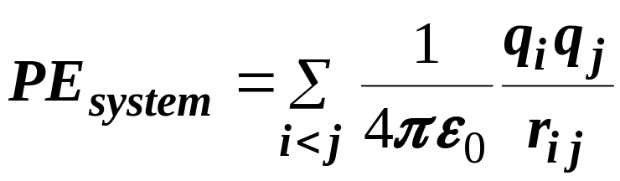
Case 2: Potential Energy of a System of Charges
Start by putting first charge in position
No work is necessary to do this
Next bring second charge into place
Now work is done by the electric field of the first charge. This work goes into the potential energy between these two charges.
Now the third charge is put into place
Work is done by the electric fields of the two previous charges. There are two potential energy terms for this step.
We continue in this manner until all the charges are in place
The total potential is then given by

Slide 12

Electric Potential
The potential at a given point
Represents the potential energy that a positive unit charge would have, if it were placed at that point
It has units of

Slide 13
Electric Potential
General Points for either positive or negative charges
The Potential increases if you move in the direction opposite to the electric field
and
The Potential decreases if you move in the same direction as the electric field

Slide 14
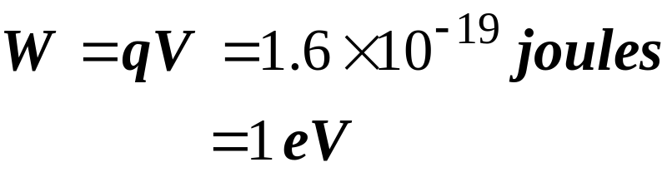
Units for Energy
There is an additional unit that is used for energy in addition to that of joules
A particle having the charge of e (1.6 x 10⁻¹⁹ C) that is moved through a potential difference of 1 Volt has an increase in energy that is given by

Slide 15
Equipotential Surfaces
It is possible to move a test charge from one point to another without having any net work done on the charge
This occurs when the beginning and end points have the same potential
It is possible to map out such points and a given set of points at the same potential form an equipotential surface

Slide 16
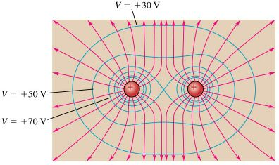
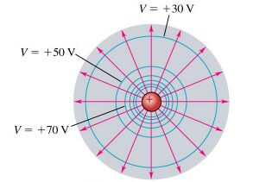
Equipotential Surfaces
Examples of equipotential surfaces
Point Charge
Two Positive Charges

Slide 17
Equipotential Surfaces
The electric field does no work as a charge is moved along an equipotential surface
Since no work is done, there is no force, qE, along the direction of motion
The electric field is perpendicular to the equipotential surface

Slide 18
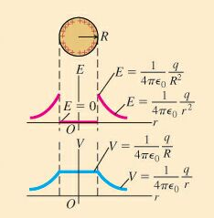
What about Conductors
The value of the potential inside the conductor is chosen to match that at the surface

